Slide 1



Project:
Python password generator

Slide 2
Project prerequisites
Tkinter is a standard GUI library and is one of the easiest ways to build a GUI application
pyperclip module allows us to copy and paste text to and from the clipboard to your computer
The random module can generate random numbers
string module contains a number of functions to process the standard python string.

Slide 3
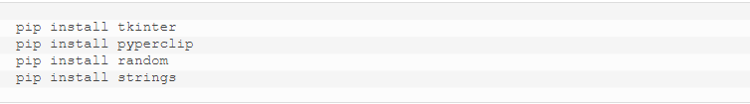
Installing the libraries:

Slide 4
Project file structure
Import modules
Initialized Window
Select Password Length
Define Functions

Slide 5
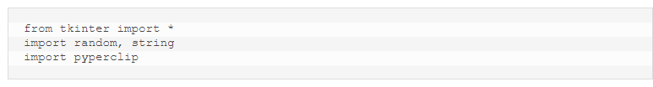
1.Importing libraries

Slide 6
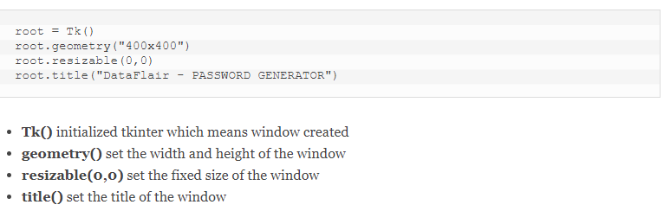
2.Initialize windows

Slide 7
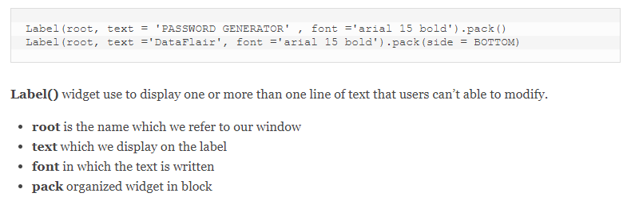
label keyword:

Slide 8
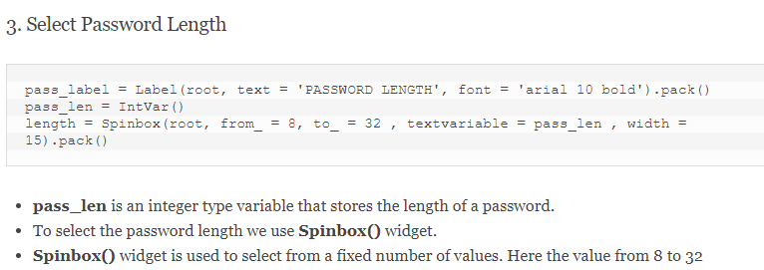
3.Select password length

Slide 9
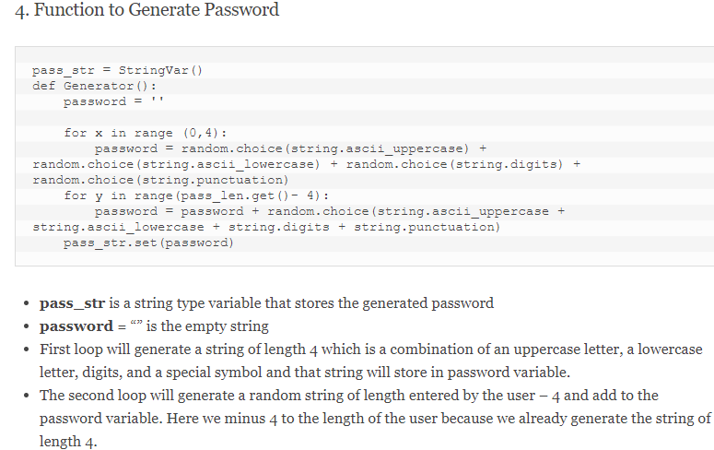
4.Function to generate password

Slide 10
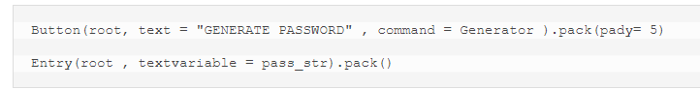
Setting the password

Slide 11
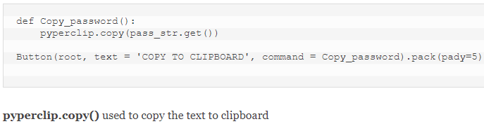
5.Function to copy password

Slide 12
summary
With these steps, we have successfully created a random password generator project using python. We used popular tkinter library to rendering graphics in our display window and we also learned about pyperclip and random library.

